Slide 1

Comparative Study of Machine Learning Techniques for Land Cover Classification
Presented By:
Amey Parle
Sanika Marathe
Swamini Sontakke
5 December, 2024

Slide 2
Introduction
Land Classification has applications in various fields : environmental monitoring, urban planning, agriculture management, and climate change assessment.
This study evaluates and compares machine learning algorithms for land cover classification using satellite imagery.
Aims to identify the most accurate and efficient techniques for land cover mapping.

Slide 3

Motivation
This comparative study is motivated by the need to:
Identify the strengths and limitations of different ML algorithms for land cover classification.
Provide insights into selecting the most suitable techniques for diverse land cover types and regions.
Contribute to advancing sustainable land management practices by improving classification accuracy and efficiency.

Slide 4
Dataset Overview
The EuroSAT dataset is a benchmark dataset for land cover classification, derived from Sentinel-2 satellite images.
It consists of RGB and multi-spectral images representing diverse land cover types across Europe.
Contains 10 classes:- agricultural, residential, industrial, forest, river, and barren land, among others.
Includes over 27,000 labeled images with a resolution of 64x64 pixels. This is split in training set of 18900 images (70%), validation set of 5400 images (20%) and test set of 2700 images(10%)
Ideal for evaluating machine learning models due to its class diversity and high-quality annotations.

Slide 5
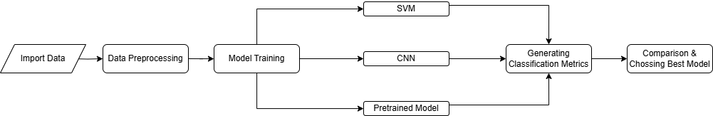
Flow Diagram

Slide 6
Models Evaluated
Advanced Machine Learning SVM
Deep Learning
CNNs
Transfer Learning:
VGG16
SVM is highly effective in handling high-dimensional data.
It supports multi-class classification through strategies like One-vs-One or One-vs-Rest.
With versatile kernel functions, SVM excels in modeling linear and nonlinear relationships.
CNNs is best known for working with Images
Provides automatic features extraction, dimensionality reduction and spatial hierarchy
Can handle large size image datasets
VGG16 is a pre-trained model,
Saves time and resources by leveraging precomputed weights.
Simple and uniform structure with 3x3 convolution filters

Slide 7

Process used for SVM
Data Preprocessing:
USed VGG16 pre-trained model for feature extraction
Converted images to arrays of pixel values
Resized images for uniformity and compatibility with the VGG16 model.
Normalized pixel values
Class labels were encoded into numerical format to support multi-class classification.
Model Training:
Utilized VGG16 for feature extraction from EuroSAT dataset images.
Trained an SVM classifier with an RBF kernel for effective boundary separation.
Fine-tuned hyperparameters like C and gamma to optimize performance.
Ensured robust evaluation using training, validation, and test datasets.
Test Results:
Training Accuracy: 88%
Validation Accuracy: 86.98%
Testing Accuracy: 87.74%

Slide 8
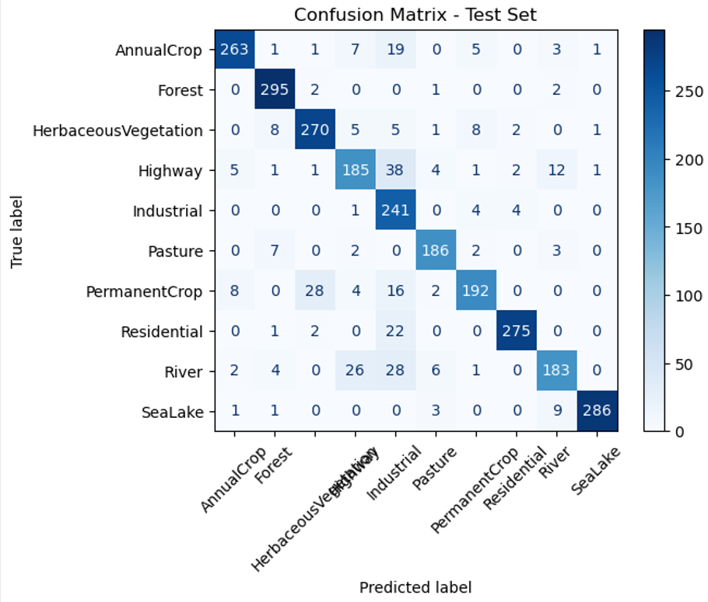
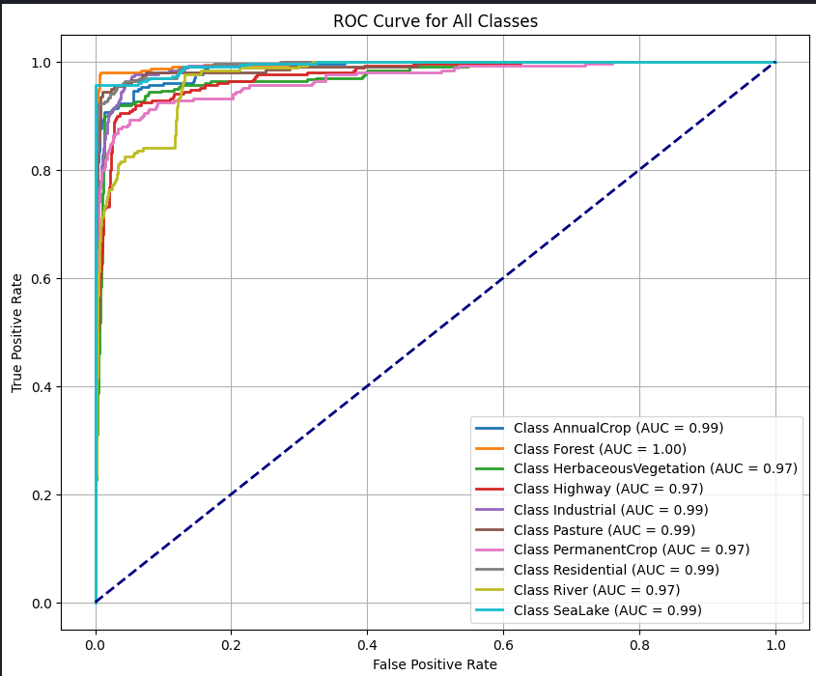
Confusion Matrix
ROC Curve

Slide 9

Process used for CNN
Data Preprocessing:
Convert images to tensor
Resize images and flip it horizontally.
Adjust brightness and contrast
Normalize Images
Model Training:
Trained a CNN model with Maxpooling layers for reducing the spatial dimensions of the feature maps.
Optimizer: Adam, Loss: sparse_categorical_entropy, Activation function:ReLU
Applied Early stopping and LR scheduler
Hyperparameter Tuning
Test Results:
Training Accuracy: 94.3%
Validation Accuracy: 92.4%
Testing Accuracy: 92.6%

Slide 10
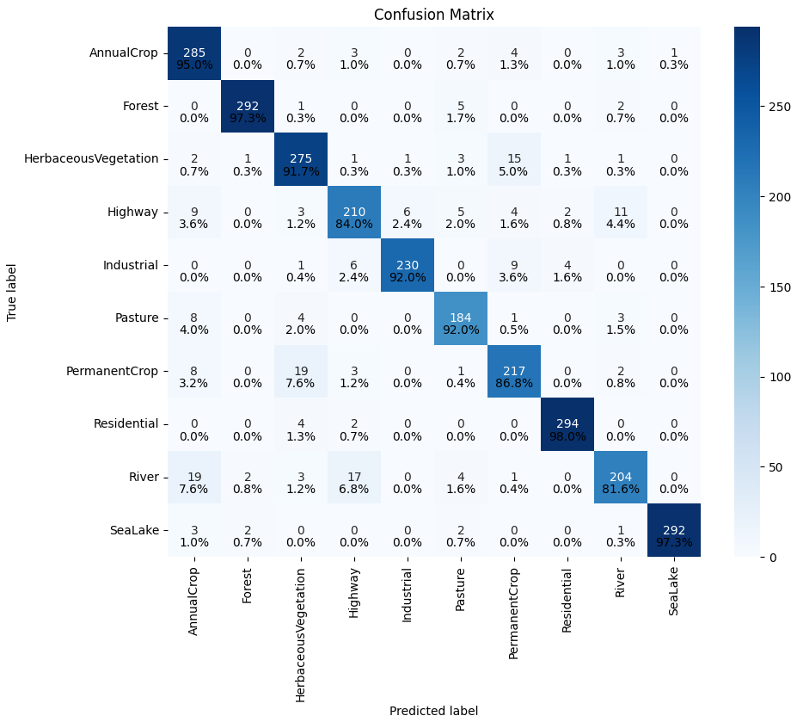
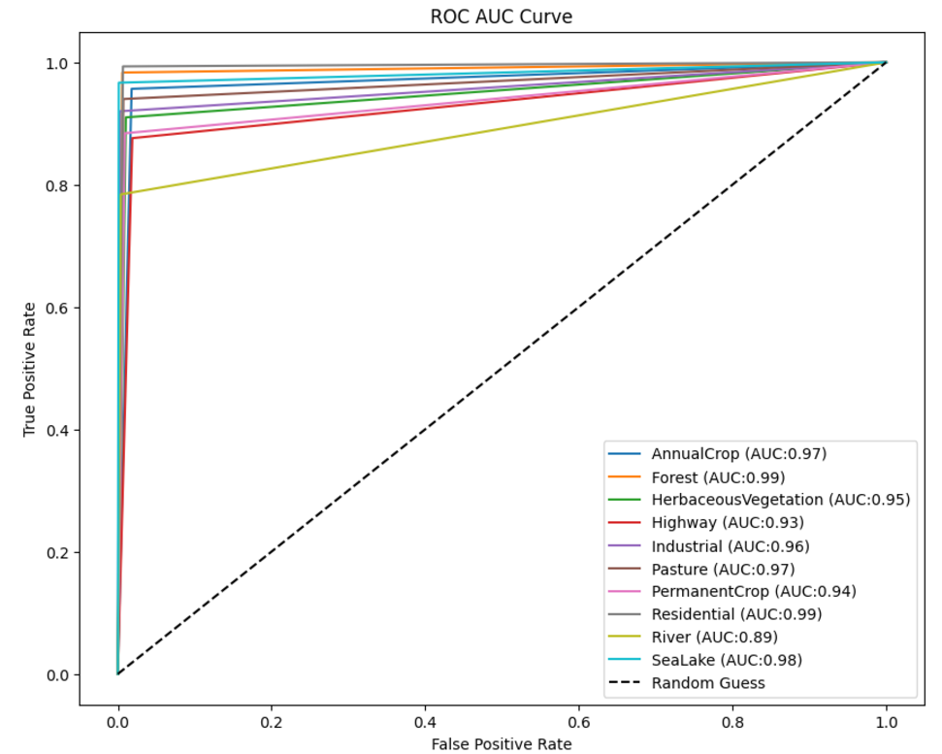
Confusion Matrix
ROC Curve

Slide 11
Process for VGG16
Data Preprocessing:
Normalization
Prefetching.
Augmentation
Label Encoding
Model Training:
A VGG16-based model was implemented using transfer learning
Dense Layer (2048 neurons, ReLU activation).
Dense Output Layer (softmax activation for multi-class classification)
Adam Optimizer.
Applied Early stopping and LR scheduler
Hyperparameter Tuning
Test Results:
Training Accuracy: 71.91%
Validation Accuracy: 71.44%
Testing Accuracy: 75.40%

Slide 12
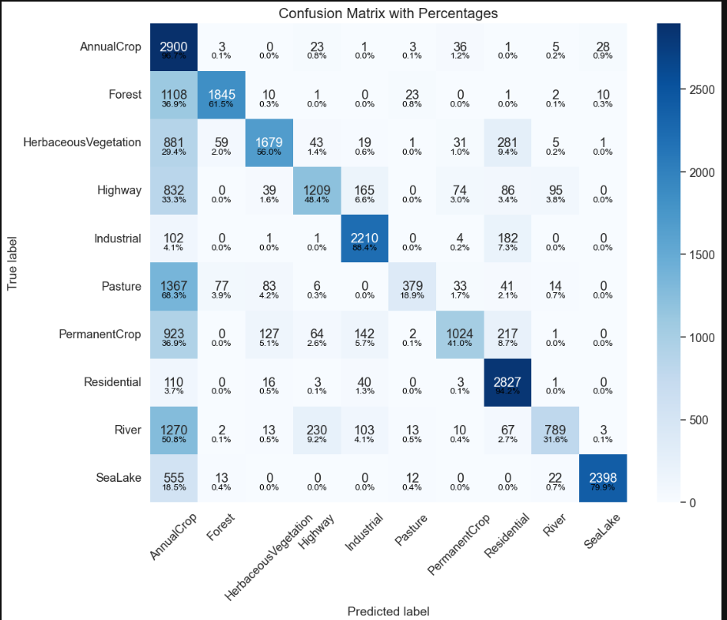
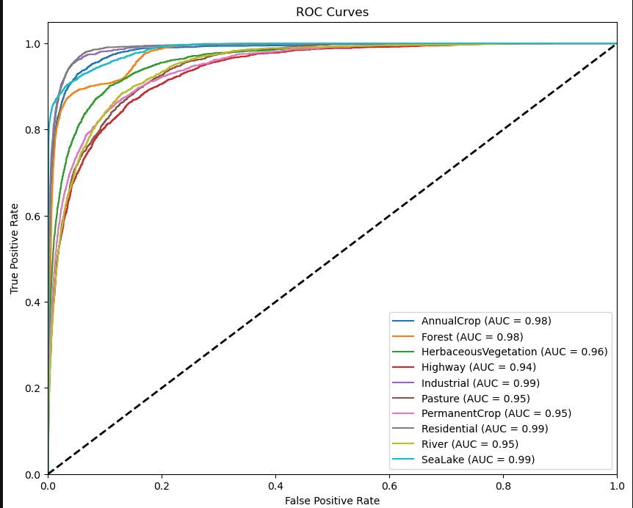
Confusion Matrix
ROC Curve

Slide 13
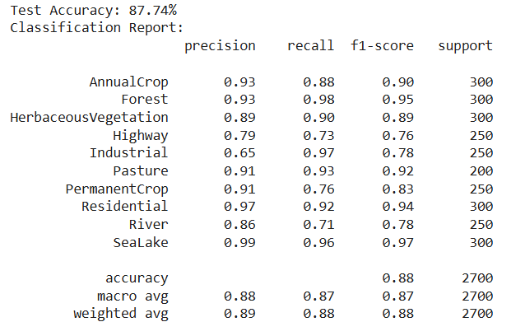
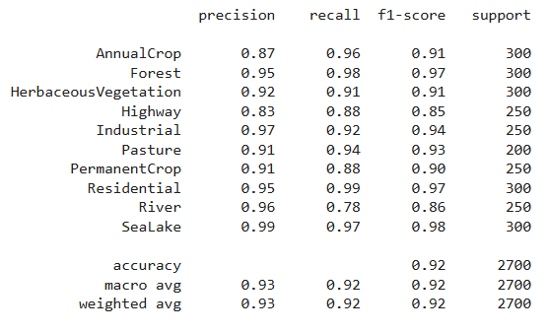
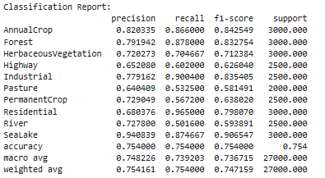
Result Comparison
Following images show the classification accuracy metrics for each of the model. Comparing these values we can observe the...
SVM
CNN
VGG16

Slide 14

Comparison Inference
SVM
Training Time: 19.45 mins
Accuracy: Satisfactory with pretrained models for preprocessing.
Memory: High Memory Consumption.
CNN Model
Training time: 13 mins
Higher Accuracy without complex data preprocessing
Memory efficient.
VGG16 Model
Training Time: 1 hr, 16 min, 50 sec
Moderately accurate with high complexity
Memory Intensive

Slide 15
Conclusion
Thus, by conducting this comparative study, we conclude that Land cover Images can be best classified using the CNN model that classifies with an accuracy of 92%.

Slide 16
Thank you

